Slide 1

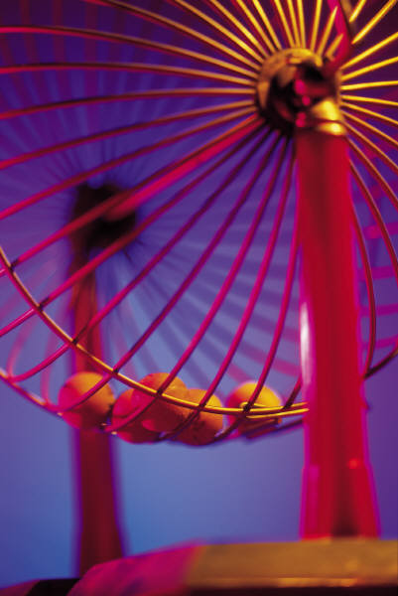

PROBABILITY

Slide 2
Birth of probability
Pascal and Fermat
Two famous mathematicians
1654 corresponded to a game
It is called the problem of points
Two players in a game and they worked out mathematically which player would win

Slide 3
What is probability?
What words do you associate with probability?

Slide 4
Probability
How likely is something going to happen?
What are the chances of an event happening?
Odds of something happening.

Slide 5
Try it yourself…
Now, could you come up with a definition for probability?

Slide 6
Definition
Probability is used to determine the chances of something occurring.

Slide 7
For Example
Probability of getting a head or tails when flipping a coin.
Probability of getting a 1-6 when rolling a die.
Probability of rain in Ireland.
Probability of getting a diamond in a deck of cards
Probability of getting a red or black card in a deck of cards.

Slide 8
For Example
Probability is often used in betting to determine the odds
The odds/probability of Offaly beating Kildare in football
The odds/probability of someone winning the X Factor this year

Slide 9
LISTING OUTCOMES
In everyday life, it is important to be able to list all the possible outcomes
that can occur in real-life situations or in experiments.

Slide 10
Example
St. Mary’s senior boys are in the Leinster
final at the end of this month,
what are the possible outcomes of the game?

Slide 11
Listing the outcomes
WIN
LOSE
DRAW
The possible outcomes are win, lose or draw.

Slide 12
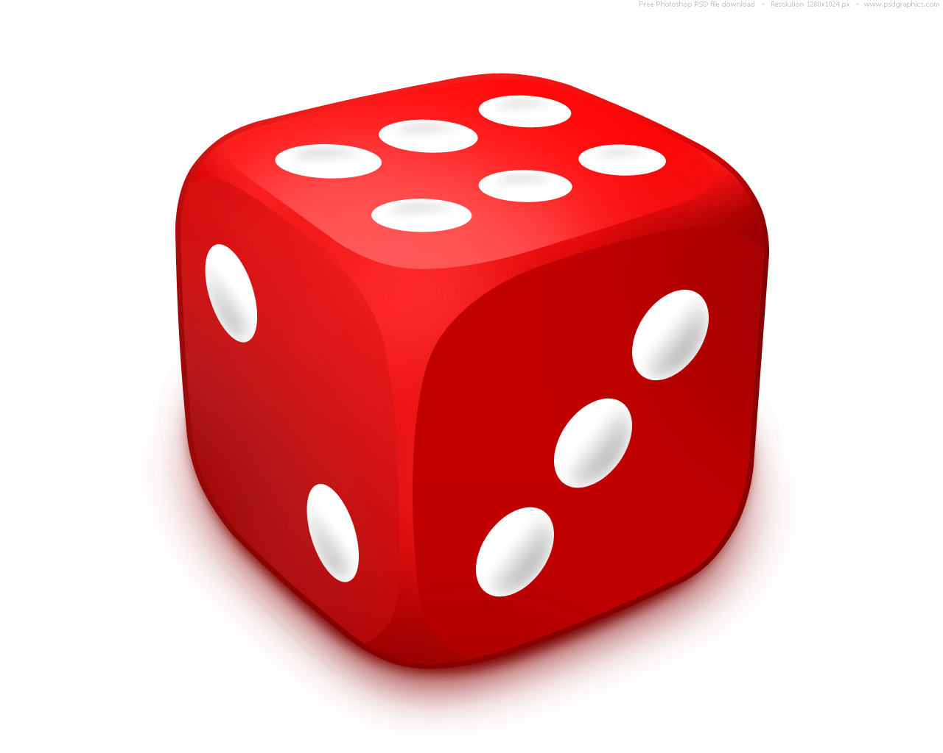
A SIX SIDED FAIR DICE
List all the possible outcomes:

Slide 13
Here are the possible outcomes
{1,2,3,4,5,6}

Slide 14
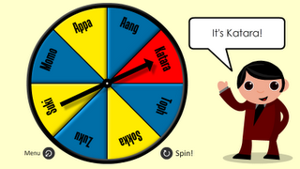
A Spinner
A spinner has eight equal sectors labelled A to H. When it is spun, what are all the possible outcomes?

Slide 15
Fundamental Principle of Counting
If one event has m possible outcomes and a second event has n possible outcomes, the two events have m x n outcomes.

Slide 16
The fundamental principle of counting
Can be extended to any number of events.

Slide 17
Example
A new car comes in five different colours and four different engine sizes. How many different options are available?

Slide 18
Solution
Different colours: 5 possible outcomes
Engine sizes: 4 possible outcomes
How many different options?
5 X 4 = 20 different types of cars.

Slide 19
Two way tables
What do you think a two way table is?

Slide 20
How many events do you think there have to be in order to use a two way table?

Slide 21
Two-Way Tables
What are they?
Tables that show data and consider two different bits of information.
E.g. whether you are a girl or boy (1st bit of info) and whether you have blond, brown or black hair (2nd bit of info)

Slide 22
A two way table is a much more convenient method of showing numerous possible outcomes

Slide 23
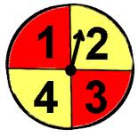
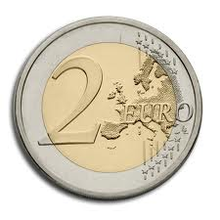
A coin is tossed and a spinner is spun. List all possible outcomes using a two way table.

Slide 24
Two dice are thrown. List all possible outcomes using a two way table.
How many outcomes are there?

Slide 25
Question
A euro coin and a dice is rolled. list all possible outcomes using a two way table.

Slide 26
Question
Liverpool FC have decided to change their away jersey for the nest years 2013/2014 season. The club have a choice of a green, grey, or white jersey and red or yellow shorts. List all the possible colours the kit could be using a two way table.

Slide 27
Question
A red and a blue die are thrown and the scores are added. List all possible outcomes using a two way table.
How many outcomes are there?
How many outcomes add up to 6?
List how many ways a score of 10 can be obtained?
What is lowest possible score?

Slide 28
Question
Two dice are thrown, a score is obtained by subtracting the lower number from the higher number. Construct a two way table and answer the following questions:
What is the most common outcome?
What is the least common outcome?
How many outcomes total to an odd number?

Slide 29
Question One
People leaving a football match were asked which team they supported and if they were happy or unhappy.
 | Man. Utd | Chelsea
Happy | 40 | 8
Unhappy | 2 | 20
How many Man. Utd supporters were happy?
How many Chelsea supporters were asked the question?
How many people were asked the question in total?
Who do you think won the football match?
Question Two
The pupils in a class conducted a survey to see who had a computer at home and who had a DVD player.
 | Dvd | No Dvd
Computer | 8 | 2
No Computer | 20 | 3
How many pupils did not have a dvd player at home?
How many pupils had neither item?
How many pupils were there in the class?

Slide 30

Probability 2

Slide 31
RECAP
What is probability?
What words do we associate with probability?
Explain outcomes?
Fundamental principle of counting?

Slide 32
Probability
How likely is something going to happen?
What are the chances of an event happening?
Odds of something happening.

Slide 33
Definition
Probability is used to determine the chances of something occurring.

Slide 34
For Example
Probability of getting a head or tails when flipping a coin.
Probability of getting a 1-6 when rolling a die.
Probability of rain in Ireland.
Probability of getting a diamond in a deck of cards
Probability of getting a red or black card in a deck of cards.

Slide 35
A SIX SIDED FAIR DICE
List all the possible outcomes:

Slide 36
Here are the possible outcomes
{1,2,3,4,5,6}

Slide 37
Fundamental Principle of Counting
If one event has m possible outcomes and a second event has n possible outcomes, the two events have m x n outcomes.

Slide 38
A coin is tossed and a spinner is spun. List all possible outcomes using a two way table.

Slide 39
Try it yourself
A two way table is a much more convenient method of showing numerous possible outcomes
Draw a 2-way table into your copy to find the possible outcomes of a coin tossed and a spinner spun.

Slide 40
People leaving a football match were asked which team they supported and if they were happy or unhappy.
How many Man. Utd supporters were happy?
How many Chelsea supporters were asked the question?
How many people were asked the question in total?
Who do you think won the football match?
 | Man. Utd | Chelsea
Happy | 40 | 8
Unhappy | 2 | 20

Slide 41
What kind of words would you use to describe the following
Offaly winning the All Ireland football championship next year.
One Directions next single going to number 1 in the charts.
Tomorrow will be 50 degrees.
I will let you off homework for the night.

Slide 42
Impossible (will never happen)
Finding a triangle with 4 sides
Someone in the class being born during World War One.
Pigs will fly.
I shall be in New Zealand tonight.
Tomorrow will be Christmas day.

Slide 43
Certain (It will definitely happen)
Someone being born today.
It will get dark tonight.
Summer will begin in May.

Slide 44
How about?
If you toss a coin you have an equal chance of getting a head or a tail.
If a baby is born it has an equal chance of being a boy or a girl.
If you roll a dice you have an equal chance of getting the number 1, 2, 3, 4, 5 or 6!

Slide 45
The likelihood scale
impossible
Very
unlikely
unlikely
Even chance
likely
Very
likely
certain

Slide 46
Language of probability
Probability is the study of how likely something is to happen.
It is measured on a PROBABILITY SCALE that ranges from IMPOSSIBLE to CERTAIN.
Impossible
Certain

Slide 47
Language of probability
Since something that has no chance of happening is IMPOSSIBLE, it is said to have a 0 % chance of happening
Impossible
Certain
0 %

Slide 48
Language of probability
Since something that is definitely going to happen is said to be CERTAIN, it is said to have 100 % chance of happening.
Impossible
Certain
0 %
100 %

Slide 49
Language of probability
If something has the same chance of happening as it has of not happening, it is said to be an EVEN CHANCE (50 %)
Impossible
Even chance
Certain
0 %
50 %
100 %

Slide 50
Language of probability
Something that is UNLIKELY to happen would be shown somewhere along here
Impossible
Even chance
Certain
25%
0 %
50 %
100 %

Slide 51
Language of probability
Something that is LIKELY to happen would be shown somewhere along here
Impossible
Even chance
Certain
75%
0 %
50 %
100 %

Slide 52
Language of probability
Although we may think of chance as 1 in 7, 3 in 5, 8 out of 10 etc, probabilities are always written as FRACTIONS, DECIMALS or PERCENTAGES.
Impossible
Even chance
Certain
Unlikely
Likely
0 %
25%
50 %
75%
100 %

Slide 53
Language of probability
Although we may think of chance as 1 in 7, 3 in 5, 8 out of 10 etc, probabilities are always written as FRACTIONS, DECIMALS or PERCENTAGES.
Impossible
Even chance
Certain
Unlikely
Likely
0
0.5
1

Slide 54
Language of probability
Although we may think of chance as 1 in 7, 3 in 5, 8 out of 10 etc, probabilities are always written as FRACTIONS, DECIMALS or PERCENTAGES.
Impossible
Even chance
Certain
Unlikely
Likely
0
1
2
1

Slide 55
Language of probability
Probabilities never have values less than 0 or more than 1 (remember 100 % is the same as 1 whole).
Impossible
Even chance
Certain
Unlikely
Likely
2
1
0
1

Slide 56
Remember probabilities never have values outside of 0 to 1
So can 4 be represented in the scale?
Can 10 be represented in the scale?
Can -15 be represented in the scale?

Slide 57
Where would the following go on the probability scale?
0 .5 1/7
1/4 .75 -6
1/2 33% 50 %
3/4 79% 10
1 3 .38

Slide 58
Where would these events go on the probability scale?
Your next holiday will be to the moon.
Picking a left shoe from a matching pair.
Scoring an even number with the throw of a dice
Getting a diamond from a deck of cards
Next year Christmas will fall in December.

Slide 59
Draw a probability scale and mark the following
You will get a 5 or a 6 on a single throw of a die
A coin will land on heads when flipped
Christopher Moloney will have a Christmas No. 1
You will pick a picture card from a pack of cards

Slide 60
Draw a probability scale and mark the following
You will pick an odd number when selecting a number between 1 and 10
There will be a heat wave in Spain next summer.
You will go to the moon this week.
You will roll a 4,5 or 6 on a throw of a die

Slide 61
Draw a probability scale and mark the following
You will win the National lottery someday.
Someone in your family will win the National Lottery.
Someone in your local area will win the National Lottery.
Someone in your county will win the National Lottery.
Someone in this Country will win the National Lottery.

Slide 62
Probability 3

Slide 63
Quick Recap
What is an outcome?
What is an event?
What is the fundamental principle of counting?
A T-shirt factory has 5 designs and each come in 6 colours. How many different types of T shirts can be produced?
John is buying a car and he has a choice of 3 makes in his price range. Each car comes in 4 colours. How many cars does he have to choose from?

Slide 64
A coin is tossed and a spinner is spun. List all possible outcomes.

Slide 65
Sample Space= {H1,H2,H3,H4,T1,T2,T3,T4}
Use ‘H’ instead of Head
And ‘T’ instead of Tails.

Slide 66
Sample Space
The list or set of all possible outcomes is referred to as the sample space.
e.g. the sample space for tossing a coin is {Head, Tail}

Slide 67
What are possible outcomes of the following events?
Katie Taylor wins a medal in the Olympics. List all the possible medals she could receive.
Michael Schumacher gets on the podium at the Monaco grand prix. What are the possible positions he could have finished in?
Leinster Vs Muster in the Heinken Cup. What are the possible results?

Slide 68
Remember to use curly brackets when listing outcomes using a sample space
For example
Katie Taylor wins a medal in the Olympics. List all the possible medals she could receive.
Sample space = {Gold, Silver, Bronze}

Slide 69
Where would the following go on the probability scale?
0
1
75%
.25
Your next holiday will be to the moon.
Next year Christmas will fall in December.
The USA will win the European championship in soccer.

Slide 70
How about?
If you toss a coin you have an equal chance of getting a head or a tail.
If a baby is born it has an equal chance of being a boy or a girl.
If you roll a dice you have an equal chance of getting the number 1, 2, 3, 4, 5 or 6!

Slide 71
Although we may think of chance as 1 in 7, 3 in 5, 8 out of 10 etc,
probabilities are always written as FRACTIONS, DECIMALS or PERCENTAGES.
Impossible
Even chance
Certain
Unlikely
Likely
0 %
25%
50 %
75%
100 %

Slide 72
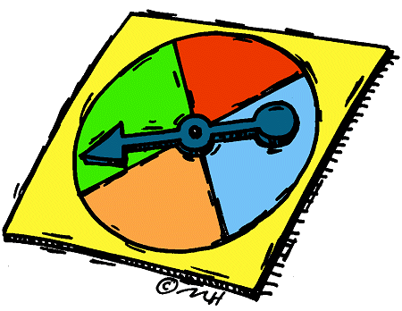
Equally likely outcomes
Outcomes of a dice - each number has the same chance of appearing.
Here we are likely to get green, red, blue or orange when this spinner is spun. These are called equally likely outcomes.

Slide 73
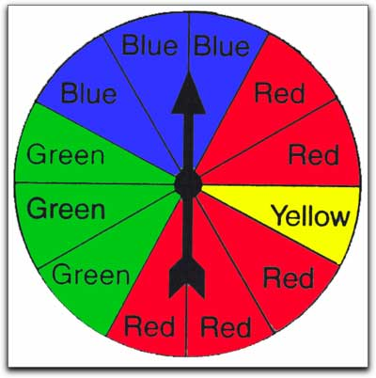
The spinner has 12 equal sectors.
When the spinner is spun, write down the number of outcomes of these events:
The spinner stops on red
The spinner stops on yellow
The spinner stops green

Slide 74
True or false?
Getting a black card or getting a red card when a card is drawn from a deck of 52 playing cards.
Getting a head or getting a tail when a fair coin is tossed
Getting an even number or getting an odd number when a card is drawn from five cards labelled: 1,2,3,4 and 5.

Slide 75
Relative frequency
What does the word frequency mean?
Can you think of another word for frequency?

Slide 76
Number of times.
Rate.
How often.
Occurrence.
Amount of times.

Slide 77
Relative Frequency
Difficult to work out the probability of an event.
For example, who is going to win the X-factor this weekend?
So we use statistical evidence from observations or experiments to determine to probability or RELATIVE FREQUENCY of an event.

Slide 78
Definition
Relative frequency or experimental probability is an estimate of the probability of an event.

Slide 79
Formula
Relative Frequency =
Frequency or number of times an event happens in a trial
Total number of trials

Slide 80
A fair die was rolled 100 times and landed on 1 twenty times. Find the relative frequency of getting a 1?

Slide 81
Frequency or number of times an event happens in a trial
Total number of trials
= 20 = 1 = 0.2 or 20%
100 5

Slide 82
NOTE
It is important to note that increasing the number of times an experiment is repeated generally leads to better estimates of probability.

Slide 83
TASK
Get into your pairs
Let’s do this experiment to see how the number of trials improves the accuracy of the relative frequency.
Each group is going to flip a coin 40 times.

Slide 84
Conclude

Slide 85
Generally
The more trials or experiments carried out, the closer the relative will be to the actual probability of an event.
Would you agree?

Slide 86

Homework
Complete the worksheet for homework tomorrow.

Slide 87
Question
Thirty students are late on a certain school day. A total of 300 students are in school that day. What is relative frequency of a student being late that day?

Slide 88
Fairness
What does the word biased mean?
What does the word unbiased mean?

Slide 89
Biased= not fair
Unbiased = fair

Slide 90
Mathematician John Kerrich tossed a coin 10,000 times while interned in a prison camp in Denmark during World War I. At various stages of the experiment, the relative frequency would climb or fall below the theoretical probability of 0.5, but as the number of tosses increased, the relative frequency tended to vary less and stay near 0.5, or 50 percent.
Was this coin unbiased/fair?

Slide 91
Answer
YES, this coin was unbiased or fair because there was an equal chance of each outcome occurring. As there were only two outcomes the coin should land on heads 50% of the time and land on tails 50% of the time.

Slide 92
Question
A coin was flipped 500 times and landed on heads 275 times.
Determine the relative frequency of the coin?
Was the coin unbiased?

Slide 93
Recap
What does relative frequency mean?
How do we find relative frequency?
What does the word unbiased mean?
Is a coin toss unbiased?
Is rolling a die fair?

Slide 94
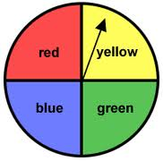
Is this spinner fair? Give reasons for your answer.

Slide 95
Who Wants To Be A Millionaire?
Probability

Slide 96
Question 1

Slide 97
A fair, six sided dice is thrown.
What is the probability of getting a 5?
^{A} ¹/₂
^{B 1}/₄
^{C} ⁵/₆
^{D 1}/₆

Slide 98
A fair, six sided dice is thrown.
What is the probability of getting a 5?
^{A 1}/₂
^{B 1}/₄
^{C} ⁵/₆
^{D} ¹/₆

Slide 99
€100

Slide 100
Question 2

Slide 101
A fair, six sided dice is thrown.
What is the probability of NOT getting a 5?
^{A 1}/₂
^{B 1}/₄
^{C 5}/₆
^{D 1}/₆

Slide 102
A fair, six sided dice is thrown.
What is the probability of getting a 5?
^{A 1}/₂
^{B 1}/₄
^{C 5}/₆
^{D 1}/₆

Slide 103
€200

Slide 104
Question 3

Slide 105
A fair, six sided dice is thrown 1200 times. How many times would you expect the number 3 to come up?
^{A} 200
^{B} 150
^{C} 0
^{D} 300

Slide 106
A fair, six sided dice is thrown 1200 times. How many times would you expect the number 3 to come up?
^{A} 200
^{B} 150
^{C} 0
^{D} 300

Slide 107
€300

Slide 108
Question 4

Slide 109
A fair, six sided dice is thrown 1200 times. How many times would you expect an even number to come up?
^{A} 300
^{B} 600
^{C} 200
^{D} 100

Slide 110
A fair, six sided dice is thrown 1200 times. How many times would you expect an even number to come up?
^{A} 300
^{B} 600
^{C} 200
^{D} 100

Slide 111
€500

Slide 112
Question 5

Slide 113
Sam’s pencil case contains 3 red, 4 blue and 5 black pens. He takes a pen without looking. What is the probability that it is blue?
^{A 4}/₁₂
^{B 3}/₁₂
^{C 5}/₁₂
^{D} none of the above

Slide 114
Sam’s pencil case contains 3 red, 4 blue and 5 black pens. He takes a pen without looking. What is the probability that it is blue?
^{A 4}/₁₂
^{B 3}/₁₂
^{C 5}/₁₂
^{D} none of the above

Slide 115
€1,000

Slide 116
Question 6

Slide 117
A spinner has 5 sections with the following numbers on it: 3 4 4 5 6
Each section is equally likely.
What is the probability of the spinner landing on the number 4?
^{A 1}/₅
^{B 2}/₅
^{C 1}/₄
^{D} 1

Slide 118
A spinner has 5 sections with the following numbers on it: 3 4 4 5 6
Each section is equally likely.
What is the probability of the spinner landing on the number 4?
^{A 1}/₅
^{B 2}/₅
^{C 1}/₄
^{D} 1

Slide 119
€2,000

Slide 120
Question 7

Slide 121
A box contains 12 red, 20 green and
8 yellow sweets. One is picked out at random. What is the probability that it is NOT red?
^{A} 0
^{B 28}/₄₀
^{C} 1
^{D} ¹²/₄₀

Slide 122
A box contains 12 red, 20 green and
8 yellow sweets. One is picked out at random. What is the probability that it is NOT red?
^{A} 0
^{B} ²⁸/₄₀
^{C} 1
^{D} ¹²/₄₀

Slide 123
€4,000

Slide 124
Question 8

Slide 125
A fair, six sided dice is thrown. What is the probability of getting a multiple of 3?
^{A} 0
^{B} ²/₆
^{C} 0.5
^{D} 1

Slide 126
A fair, six sided dice is thrown. What is the probability of getting a multiple of 3?
^{A} 0
^{B} ²/₆
^{C} 0.5
^{D} 1

Slide 127
€8,000

Slide 128
Question 9

Slide 129
The probability of Persia winning a race is 0.2
What is the probability that she does NOT win?
^{A} 0
^{B} 0.8
^{C} 1
^{D} 0.2

Slide 130
The probability of Persia winning a race is 0.2
What is the probability that she does NOT win?
^{A} 0
^{B} 0.8
^{C} 1
^{D} 0.2

Slide 131
€16,000

Slide 132
Question 10

Slide 133
The probability that it will rain today is 0.85
What is the probability that it will not rain?
^{A} 0
^{B} 0.5
^{C} 0.15
^{D} 1

Slide 134
The probability that it will rain today is 0.85
What is the probability that it will not rain?
^{A} 0
^{B} 0.5
^{C} 0.15
^{D} 1

Slide 135
€32,000

Slide 136
Question 11

Slide 137
A family has three children. One possibility is 2 boys and 1 girl. How many possibilities are there?
^{A} 3
^{B} 4
^{C} 6
^{D} 8

Slide 138
A family has three children. One possibility is 2 boys and 1 girl. How many possibilities are there?
^{A} 3
^{B} 4
^{C} 6
^{D} 8

Slide 139
€64,000

Slide 140
Question 12

Slide 141
A fair spinner has four sections labelled
1 3 5 7
The spinner is spun and a fair coin is tossed.
What is the probability of getting: tails and a number less than 4
^{A} 0
^{B} ¹/₄
^{C} ¹/₂
^{D} 1

Slide 142
A fair spinner has four sections labelled
1 3 5 7
The spinner is spun and a fair coin is tossed.
What is the probability of getting: tails and a number less than 4
^{A} 0
^{B} ¹/₄
^{C} ¹/₂
^{D} 1

Slide 143
€125,000

Slide 144
Question 13

Slide 145
What is the probability of getting Head, Head, Head if you toss a coin three times?
^{A} 0
^{B} ¹/₂
^{C} ¹/₈
^{D} 1

Slide 146
What is the probability of getting Head, Head, Head if you toss a coin three times?
^{A} 0
^{B} ¹/₂
^{C} ¹/₈
^{D} 1

Slide 147
€250,000

Slide 148
Question 14

Slide 149
If you toss a coin, what is the probability of getting a head or a tail?
^{A} 0
^{B} ¹/₂
^{C} 1
^{D} ¹/₄

Slide 150
If you toss a coin, what is the probability of getting a head or a tail?
^{A} 0
^{B} ¹/₂
^{C} 1
^{D} ¹/₄

Slide 151
€500,000

Slide 152
Question 15

Slide 153
You roll two dice and add the numbers on the top face of each dice. What is the probability of getting 12 as a total?
^{A} ¹/₃₆
^{B 1}/₆
^{C 1}/₁₂
^{D} 1

Slide 154
You roll two dice and add the numbers on the top face of each dice. What is the probability of getting 12 as a total?
^{A} ¹/₃₆
^{B 1}/₁₂
^{C 1}/₆
^{D} 1

Slide 155
€1,000,000

